Slide 1
2015
Homeopathy and Laws
Diane Miller JD
Director of Law and Public Policy
National Health Freedom Coalition

Slide 2
National Health Freedom Coalition a non-profit educational organization
PMB 218, 2136 Ford Parkway, St. Paul, MN , USA 55116-1863
www.nationalhealthfreedom.org
E-mail: similars@aol.com

Slide 3
HOMEOPATHY in the context of government and laws
GOVERNMENT and laws in the context of homeopathy

Slide 4
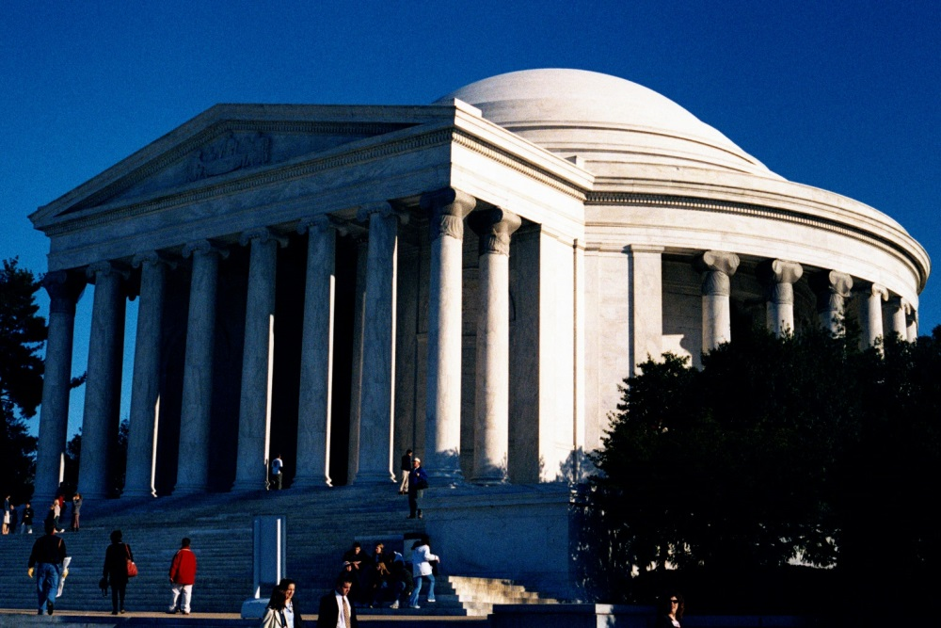
Government
Laws are made to regulate people as they apply to commerce and services within and between states and countries including:
homeopathic remedies
and
homeopaths

Slide 5
Homeopathy
“In the state of health the spirit-like vital force (dynamis) animating the material human organism reigns in supreme sovereignty.”

Slide 6
Governments v. Homeopathy
Primary Problem:
Legal Overbreadth and Oppression
Secondary Problem:
Failed Attempts at Solutions
Tertiary Disease:
Disintegration of Diverse Strong Healing Community

Slide 7
Community Disease
Turf Battles: between licensed or credentialed professions
Innovation Banned: prevailing and accepted conventional medical standards and policies enforced
Revocation of Right to Practice: punishment for practicing
Prosecutions: persecuted if not following government mandates
Consumer Deaths: unnecessary illness and deaths
Consumer Access Denied: innovative and low risk modalities not freely accessible

Slide 8
HOMEOPATHIC APPROACH TO STRENGTHENING
HOMEOPTHIC COMMUNITY
HOMEOPATHIC TOUCH STONES FOR HEALING
The Material Human Organism:
The Homeopathic Community
The Spirit-Like Vital Force (Dynamis):
Soul …Breath of Life…Family Bonds…
Group Consciousness… Synchronicity…
The Universe

Slide 9
Material Organism Symptoms
Disagreements within community regarding expectations for protection of the right to practice and manufacturing of remedies
Promotion stifled by lack of unified power
Isolationism and small segments domination
Lack of secure destination for large resources and projects
Health seeker hurdles to access and establish relationship with homeopaths
Health seekers hurdles to understand homeopathic approach and concepts of use

Slide 10
The homeopathic community animated
“Without the vital force the material organism is unable to feel, or act, or maintain itself. (Without the vital force the body dies; and then, delivered exclusively to the forces of the outer material world, it decomposes, reverting to its chemical constituents.
Only because of the immaterial being (vital principle, vital force) that animates it in health and in disease can it feel and maintain its vital functions.”
Samuel Hahnemann, Organon of Medicine, 1982 by The Hahnemann Foundation, translated by Jost Kunzli M.D., Alain Naude and Peter Pendleton, 10, Page 15..

Slide 11
Choice of Remedy
“…It is the invisible energy of the crude substance released and freed to the highest possible extent which is o be found in the minute impregnated globule or its solution. Upon contact with living tissue, this medicinal force acts dynamically on the whole organism in a specific way, without communicating to it the smallest t material particle, however subtle: and it does so more and more powerfully as it becomes freer and less material through progressive dynamization” (par. 270)
Samuel Hahnemann, Organon of Medicine, 1982 by The Hahnemann Foundation, translated by Jost Kunzli M.D., Alain Naude and Peter Pendleton, 11, Page 18.

Slide 12
One Person’s Discernment
“A healthy person or community will throw off too much restriction of sovereignty in order to control their own destiny.” Diane Miller
Solution:
Control in the “least restrictive means” to the point where there is no substance left except the essence of order and harmony: “responsible freedom”.

Slide 13
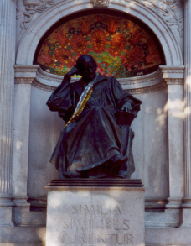
Remedy
Freedom
“In a harmonious community there dwells a group consciousness that animates the community persona while holding sacred and responsible the individual sovereign life experience to reign supreme.”
Diane Miller
Group Consciousness

Slide 14

Remedy Freedom
“the least restrictive means”
…where fundamental liberties are at stake.
Balance and Harmony

Slide 15
Fundamental right
to heal and survive

Slide 16
Continual universal growth
of new healing information

Slide 17
Professional callings
to grow and learn and act upon it

Slide 18
Freedom to Access
to follow your path to health

Slide 19
Do no Harm
Safety questions
are not the same as
Efficacy questions

Slide 20
Tolerance and Respect
creating avenues of understanding

Slide 21
Disclosures Transparency
encourages innovation and freedom

Slide 22
Government Expectation
Protect health freedom and make no law abridging health freedom or its fundamental principles

Slide 23
Progress
“Laws and customs must be
carefully reviewed, revised, and even repealed if necessary, and new laws created, to reflect the development, evolution, and spiritual maturization of a people.”
Diane Miller JD

Slide 24
National Health Freedom Coalition
Promoting access to all health care information, services, treatments and products that the people deem beneficial for their own health and survival; promoting an understanding of the laws and factors impacting the right to access; and promoting the health of the people of this nation.
PMB 218, 2136 Ford Parkway, St. Paul, MN 55116-1863 Phone: 507-663-9018 www.nationalhealthfreedom.org

Slide 25
National Health Freedom Coalition a non-profit educational organization
PMB 218, 2136 Ford Parkway, St. Paul, MN , USA 55116-1863
www.nationalhealthfreedom.org
E-mail: similars@aol.com

